Slide 1


Lecture 4 Complexity
DATA STRUCTURE
AND ALGORITHMS
(CS 201)
4
Fall (2025-2026)

Slide 2
Course Learning Objectives
Implement and manipulate linear data structures such as arrays and linked lists, performing fundamental operations including insertion, deletion, and traversal.
Apply and implement special linear data structures such as stacks and queues, utilizing their core operations (push, pop, enqueue, and dequeue).
Design and implement basic sorting algorithms to organize data efficiently.
Apply searching algorithms, including sequential search, binary search, and hashing techniques.
Implement and manipulate non-linear data structures, particularly binary trees and binary search trees, performing key operations such as insertion, deletion, and traversal.
Utilize graph data structures and apply fundamental graph algorithms for problem-solving.
Demonstrate effective teamwork skills by collaborating within groups to develop algorithmic solutions.

Slide 3
Agenda
What is an Algorithm?
Data Structures Definition
The analysis framework
  Order of growth
  Worst case, best case and average case efficiencies
  Importance of analysis
Asymptotic notations and basic efficiency classes
1-3
Notes:
3

Slide 4
What is an Algorithm?
An Algorithm is:
  A sequence of well-defined instructions for solving a problem.
  A computational procedure that takes some values as input and produces some values as output.
  A procedure for getting answers to a specific problem
  A problem solving strategy even if computers are not involved.
Notes:
4

Slide 5
Why do you need to study algorithms?
Practical reasons
  Know a standard set of important algorithms from different areas of computing.
  Be able to design new algorithms and analyze their efficiency.
Theoretical reasons
  The study of algorithms was recognized as the cornerstone of computer science.
  Studying algorithms helps in developing analytical skills.

Slide 6
Data Structure Definition
Data structure is representation of the logical relationship existing between individual elements of data.
In other words, a data structure is a way of organizing all data items that considers not only the elements stored but also their relationship to each other.
Notes:
In other words, a data structure is a way of organizing all data items that considers not only the elements stored but also their relationship to each other.
Data structure affects the design of both structural & functional aspects of a program.
<number>

Slide 7
Analysis of Algorithms
How good is the algorithm?
  Efficiency
    Time efficiency
    Space efficiency
Notes:
7

Slide 8
Analysis Framework
Measuring an input’s size
  All algorithms run longer on larger input
  An algorithm’s efficiency is a function of “n” which is the algorithm’s input size
  Example:
    Sorting an array : the input size is the array length
Measuring running time
  Counting the number of times the algorithm’s “basic operation” is executed on inputs of size “n”
Notes:
8
Basic operation : the operation contributing most of the running time

Slide 9
Analysis Framework
Time efficiency is analyzed by determining the number of repetitions of the basic operation as a function of input size
Basic operation: the operation that contributes the most towards the running time of the algorithm
T(n) ≈ c_{op} C (n)
input size
running time
execution time
for basic operation
or cost
Number of times basic operation is executed
Notes:
9

Slide 10
Example
Problem | Input size measure | Basic operation
Searching for key in a list of n items | Number of list’s items, i.e. n | Key comparison
Multiplication of two matrices | Matrix dimensions or total number of elements | Multiplication of two numbers
Notes:
Check if a number is prime or not :
- In practice, one often wants to check whether a given number is prime, rather than generate a list of primes as the two mentioned sieve algorithms do.
- The most basic method to do this, known as trial division, works as follows: given a number n, one divides n by all numbers m less than or equal to the square root of that number. If any of the divisions come out as an integer, then the original number is not a prime. Otherwise, it is a prime.
<number>

Slide 11
Importance of analysis
Assume:
  Algorithm X takes time 2n² (written by best programmer) running on machine with 1000 MIPS (Million instructions per second)
  Algorithm Y takes time 50n lg n (written by worst programmer) running on machine with 10 MIPS
Running time for 10⁶ numbers
  Algorithm X takes 2000 seconds
  Algorithm Y takes 30 seconds
Complexity makes a huge difference!
Notes:
11

Slide 12
Order of growth
The rate of increase in operations for an algorithm to solve a problem as the size of the problem increases.
This is referred to as the rate of growth of the algorithm.
Increasing input size increases the complexity
Notes:
12
Example: cn²
how much faster on twice as fast computer? (2)
how much longer for 2n? (4)

Slide 13
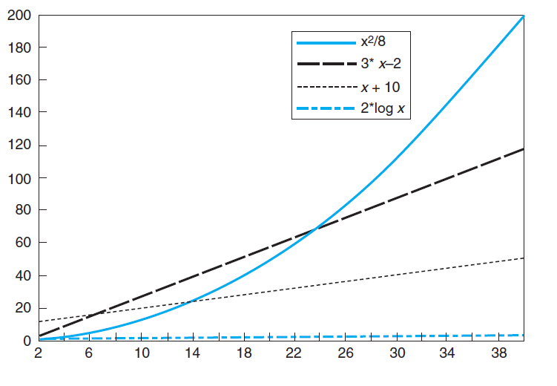
Order of growth
The function based on x² increases slowly at first, but as the problem size gets larger, it begins to grow at a rapid rate.
The functions that are based on x both grow at a steady rate for the entire length of the graph.
The function based on log x seems to not grow at all, but this is because it is actually growing at a very slow rate.
Notes:
13
Example: cn²
how much faster on twice as fast computer? (2)
how much longer for 2n? (4)

Slide 14
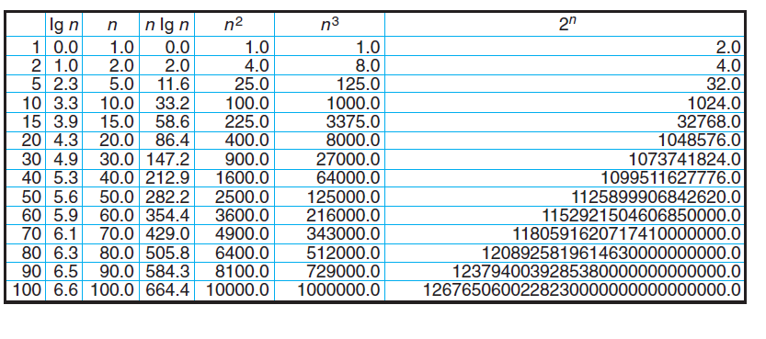
Values of some important functions as n → ∞
Notes:
14

Slide 15
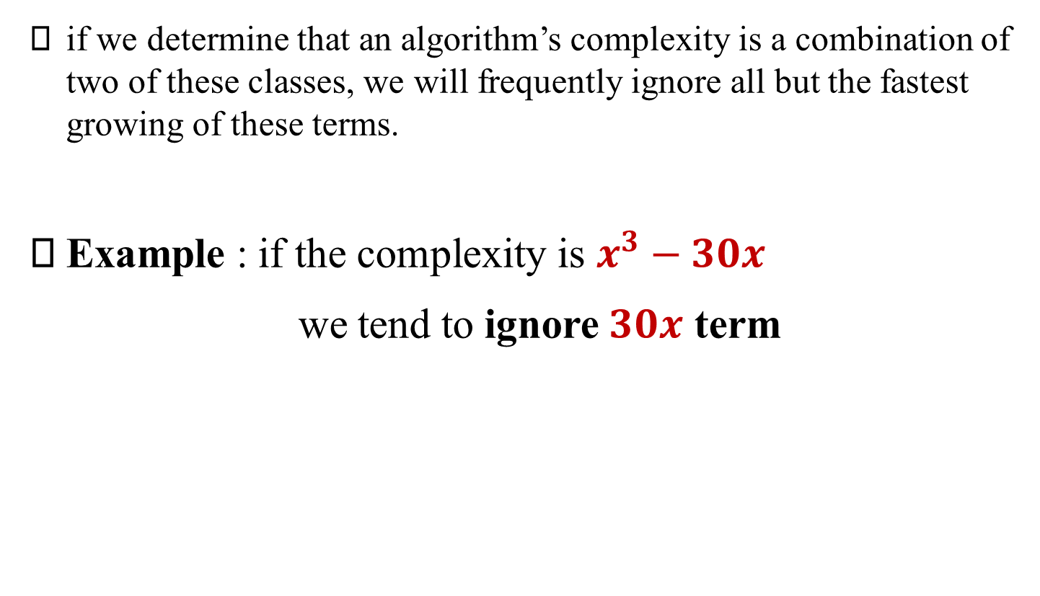
Order of growth
if we determine that an algorithm’s complexity is a combination of two of these classes, we will frequently ignore all but the fastest growing of these terms.
Example : if the complexity is $x^{3}−30x$
we tend to ignore $30x$ term
Notes:
15
Example: cn²
how much faster on twice as fast computer? (2)
how much longer for 2n? (4)

Slide 16
Kinds of analysis
For some algorithms, efficiency depends on form of input:
Worst case: C_{worst}(n) – maximum time of algorithm over inputs of size n
Best case: C_{best}(n) – minimum time of algorithm over inputs of size n
Average case: C_{avg}(n) – “average” over inputs of size n
Notes:
16

Slide 17
Classification of Growth
Asymptotic order of growth
A way of comparing functions that ignores constant factors and small input sizes.
O(g(n)): class of functions f(n) that grow no faster than g(n)
  All functions with smaller or the same order of growth as g(n)
Ω(g(n)): class of functions f(n) that grow at least as fast as g(n)
  All functions that are larger or have the same order of growth as g(n)
Θ(g(n)): class of functions f(n) that grow at same rate as g(n)
  Set of functions that have the same order of growth as g(n)
Notes:
17

Slide 18

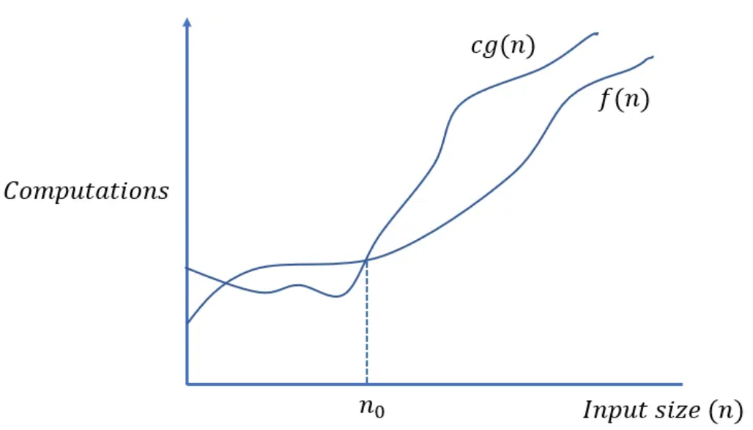
Big-oh
O(g(n)): class of functions f(n) that grow no faster than g(n)
if there exist some positive constant c and some nonnegative n0 such that
Notes:
18
Upper bound: it bounds the growth of the running time from above for large enough input sizes.

Slide 19
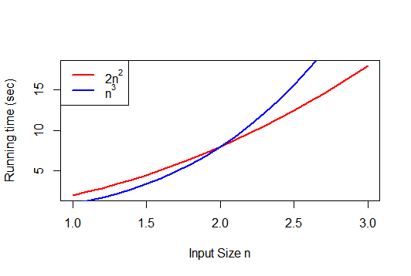
Notes:
19

Slide 20

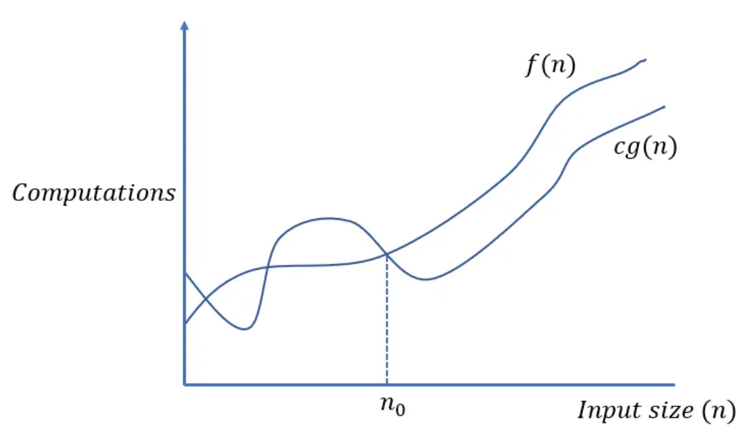
Big-omega
Ω(g(n)): class of functions f(n) that grow at least as fast as g(n)
Notes:
20
Lower bound : it bounds the growth of the running time from below for large enough input sizes.

Slide 21
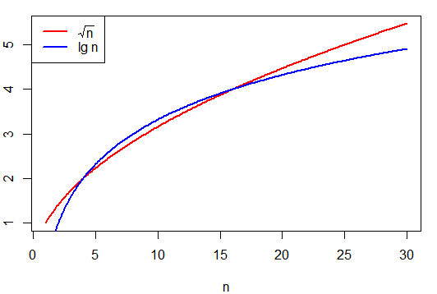
Notes:
21

Slide 22

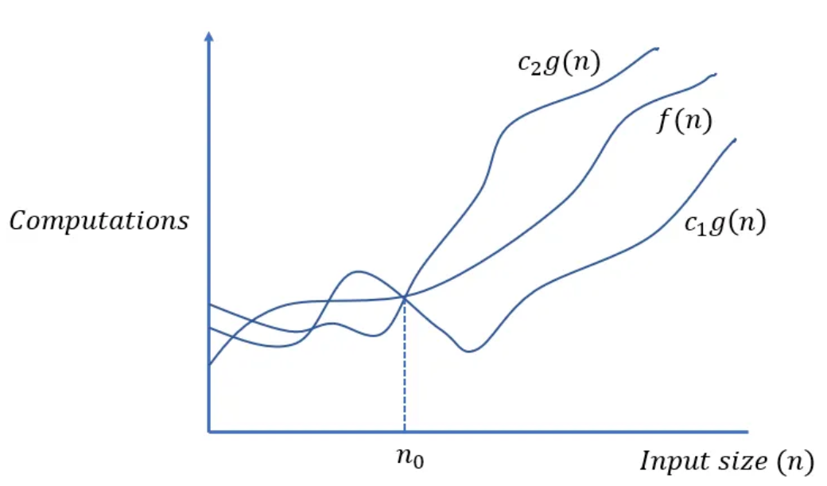
Big-theta
Θ(g(n)): class of functions f(n) that grow at same rate as g(n)
Notes:
22
Tight bound

Slide 23
Summary
>=
Ω(g(n)), functions that grow at least as fast as g(n)
=
Θ(g(n)), functions that grow at the same rate as g(n)
g(n)
<=
O(g(n)), functions that grow no faster than g(n)

Slide 24
Basic asymptotic efficiency classes
1 | constant
log n | logarithmic
n | linear
n log n | n-log-n
n² | quadratic
n³ | cubic
2^{n} | exponential
n! | factorial
Notes:
24

Slide 25
Analysis of Non recursive Algorithms
General Plan for Analysis
Decide on parameter n indicating input size.
Identify algorithm’s basic operation.
Determine worst, average, and best cases for input of size n.
Set up a sum for the number of times the basic operation is executed.
Simplify the sum using standard formulas and rules.
Notes:
25

Slide 26
Useful summation formulas and rules
Σ_{l≤i≤u}1 = 1+1+ ⋯ +1 = u - l + 1
In particular, Σ_{l≤i≤u}1 = n - 1 + 1 = n ∈ Θ(n)
Σ_{1≤i≤n} i = 1+2+ ⋯ +n = n(n+1)/2 ≈ n²/2 ∈ Θ(n²)
Σ_{1≤i≤n} i² = 1²+2²+ ⋯ +n² = n(n+1)(2n+1)/6 ≈ n³/3 ∈ Θ(n³)
Σ_{0≤i≤n} a^{i} = 1 + a + ⋯ + a^{n} = (a^{n+1} - 1)/(a - 1) for any a ≠ 1
In particular, Σ_{0≤i≤n} 2^{i} = 2⁰ + 2¹ + ⋯ + 2^{n} = 2^{n+1} - 1 ∈ Θ(2^{n} )
Σ(a_{i} ± b_{i} ) = Σa_{i} ± Σb_{i} Σca_{i} = cΣa_{i} Σ_{l≤i≤u}a_{i} = Σ_{l≤i≤m}a_{i} + Σ_{m+1≤i≤u}a_{i}
26
Notes:
26

Slide 27
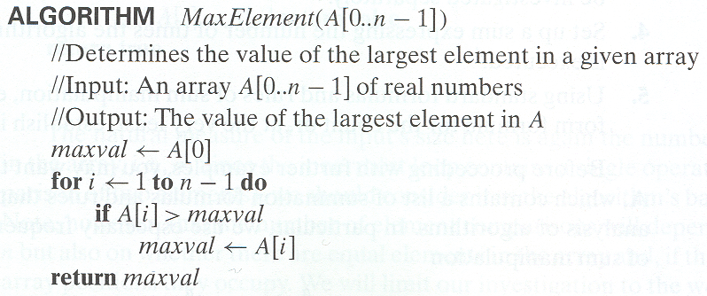
Example 1: The Largest Element
T(n) = Σ1≤i≤n-1 (1) = n-1 = Ο(n) comparisons

Slide 28
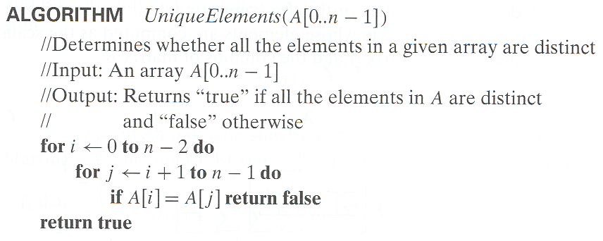



Example 2
Element uniqueness problem
= Ο( $n^{2}$ )

Slide 29
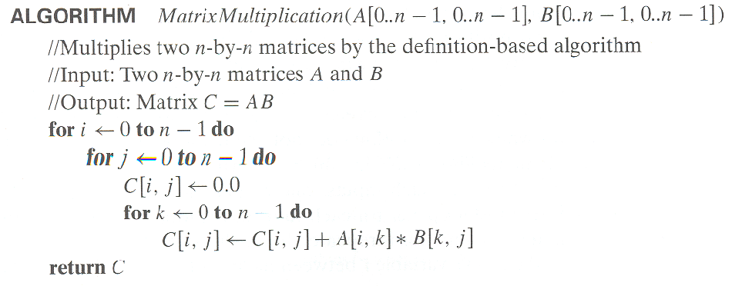
Example 3
Matrix multiplication
T(n) = = Ο( ) multiplications
Ignored addition for simplicity

Slide 30
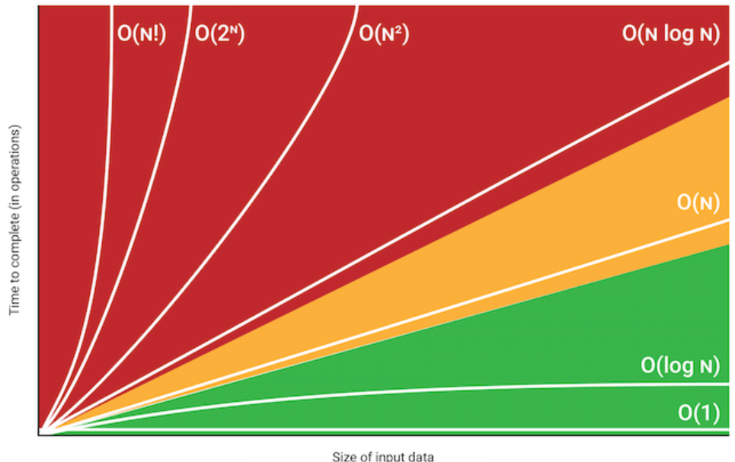
Big-oh (summary)

Slide 31



